Slide 1
Azure Artifactory
OW

Slide 2
Overview
Azure Artifacts enables developers to efficiently manage all their dependencies from one place.
With Azure Artifacts, developers can publish packages to their feeds and share them within their team, across organizations, and even publicly across the internet.
Azure Artifacts if you need to share packages within the same team, across organizations, or even publicly.

Slide 3
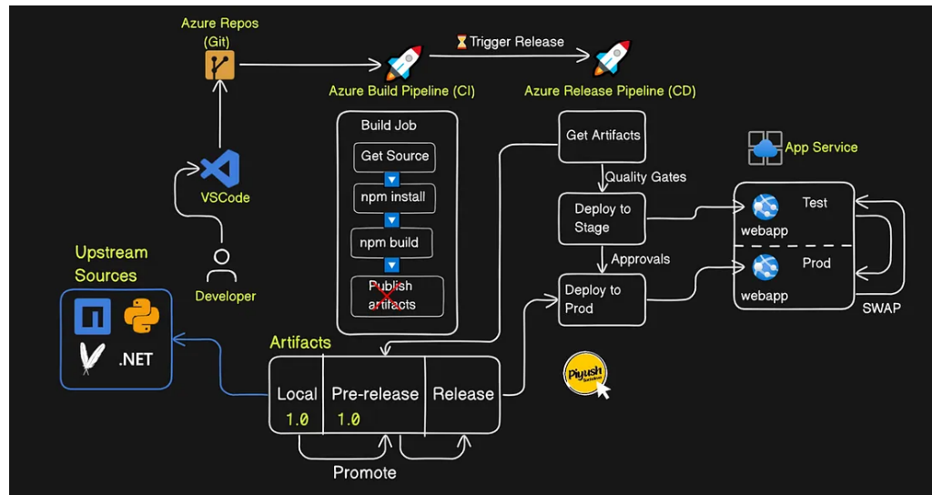
..

Slide 4
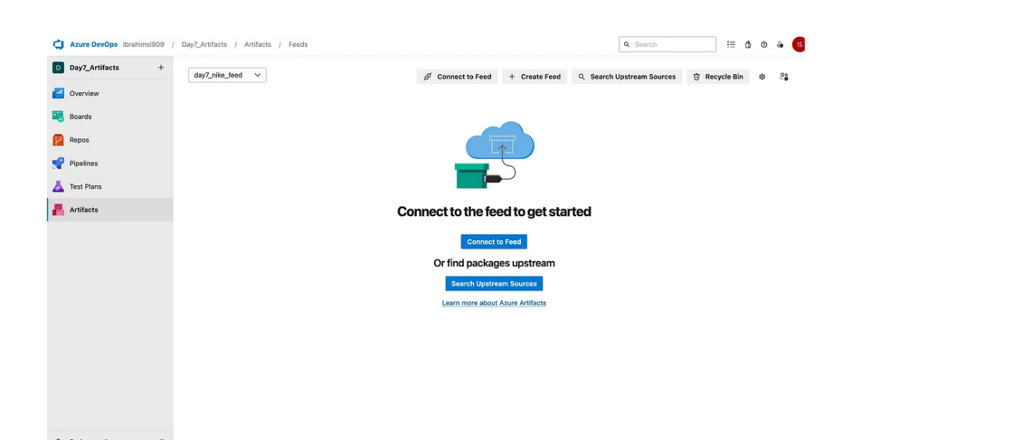
..

Slide 5
..
- task: PublishBuildArtifacts@1
inputs:
PathtoPublish: '/home/amit/drop'
ArtifactName: 'amit0682'
publishLocation: 'Container’
Specifies where to publish the artifacts. In this case, it's set to 'Container', indicating that artifacts will be published to a container in Azure Pipelines.

